Slide 1


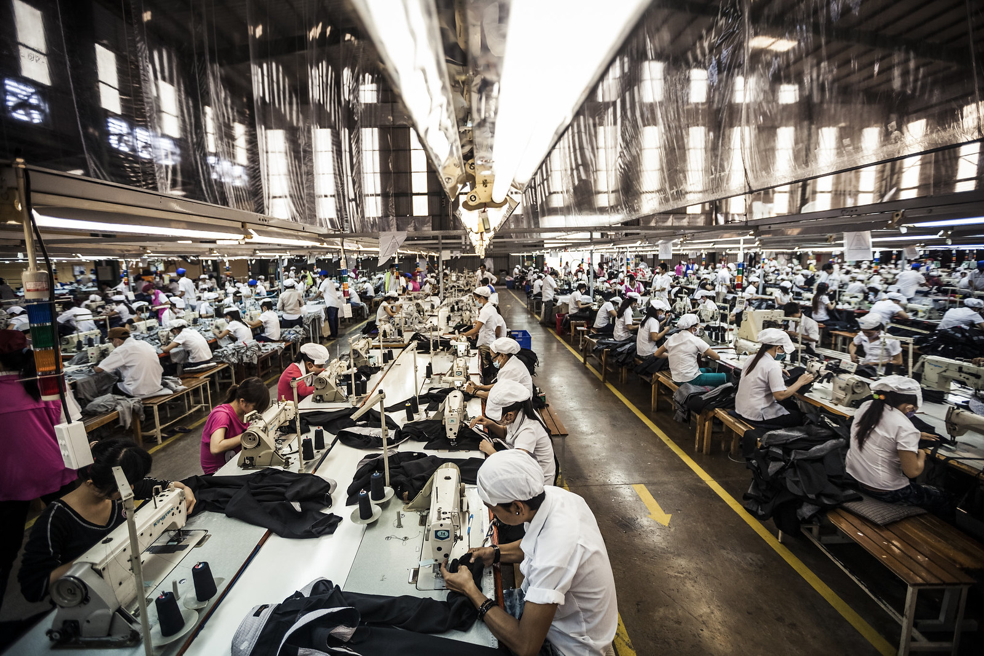

Garment worker performance prediction (Regression Project)
BY Group 3 Team members : Rajput Siddhi Thakur Swetha vaddepalli murali Shaik Anas Bharath
Aurora Degree & PG college

Slide 2
INDEX
CONTENT
Background, objective and path
Variable description
Data pre-processing
EDA
Machine learning algorithms
Conclusion
Appendix
SLIDES NUMBERS
1
2,3
4
5,6,8,9,10
11,12,13,14,15,16,17,18,19
20
22,23,24,25

Slide 3
BACKGROUND
1
The Garment Industry is one of the key examples of the industrial globalization of this modern era.
This dataset includes important attributes of the garment manufacturing process and the productivity of the employees.
OBJECTIVE
To evaluate the productivity of workers and to come up with solutions to improve the productivity.
THE PATH
Team followed standard Machine Learning algorithms development process to fit the best model to evaluate the productivity of workers.

Slide 4
VARIABLE DESCRIPTION
2
VARIABLE | DESCRIPTION
DATE | Date in MM-DD-YYYY
DAY | Day of the Week
QUARTER | A portion of the month. A month was divided into four quarters
DEPARTMENT | Associated department with the instance
TEAM NO | Associated team number with the instance
NO OF WORKERS | Number of workers in each team
NO OF STYLE CHANGE | Number of changes in the style of a particular product

Slide 5
3
VARIABLE | DESCRIPTION
TARGETED PRODUCTIVITY | Targeted productivity set by the Authority for each team for each day.
SMV | it is the allocated time for a task .
WIP | Includes the number of unfinished items for products .
OVER TIME | Represents the amount of overtime by each team in minutes
INCENTIVE | Represents the amount of financial incentive that enables or motivates a particular course of action.
IDLE TIME | The amount of time when the production was interrupted due to several reasons
IDLE MEN | The number of workers who were idle due to production interruption
ACTUAL PRODUCTIVITY | The actual % of productivity that was delivered by the workers. It ranges from 0-1.

Slide 6
DATA PRE –PROCESSING
4
DATA CLEANING
In the data set for the department column we removed the space and replaced sewing with sewing
HANDLING MISSING VALUES
There are null values in the WIP column of the data set . So, first we replaced the null values with '0' then we replaced the '0' with the mean of the column .
DUMMY VARIABLE ENCODING
In the data set for day column we replaced the week days by '0' and week end by '1'
We created dummy variables for department and quarter columns using get dummy().

Slide 7
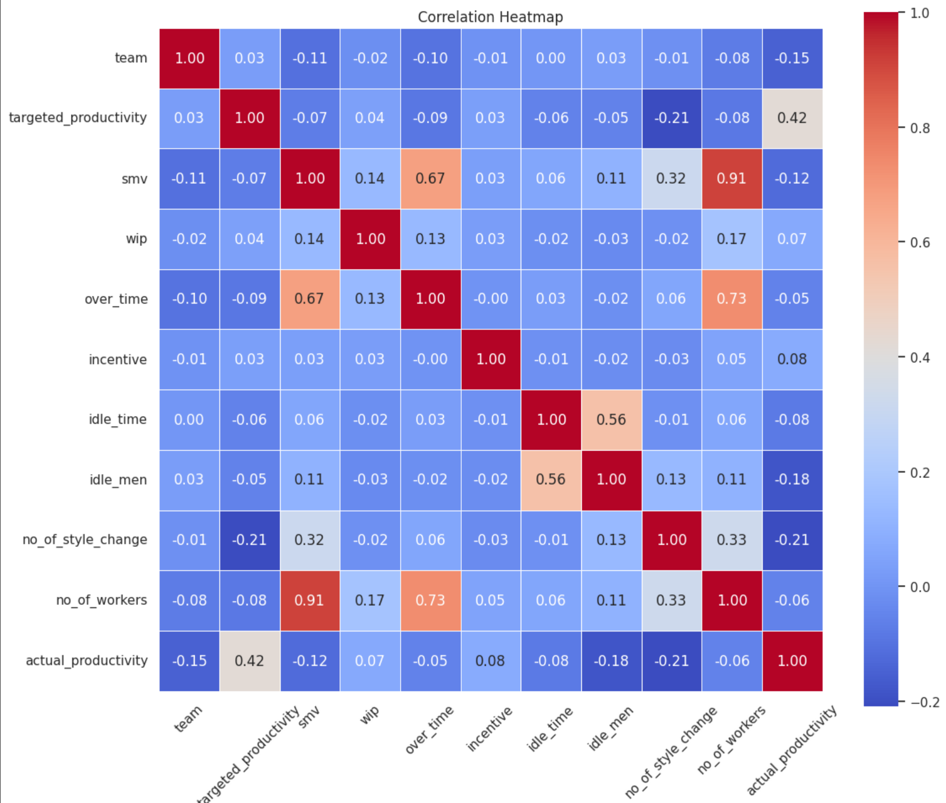
5
EXPLORATORY DATA ANALYSIS (EDA):=
HEAT MAP

Slide 8
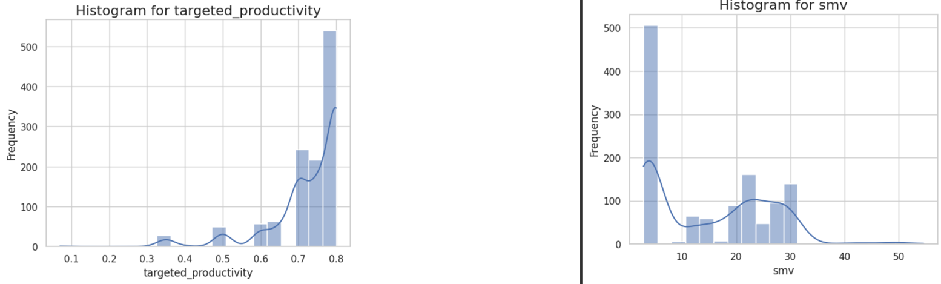
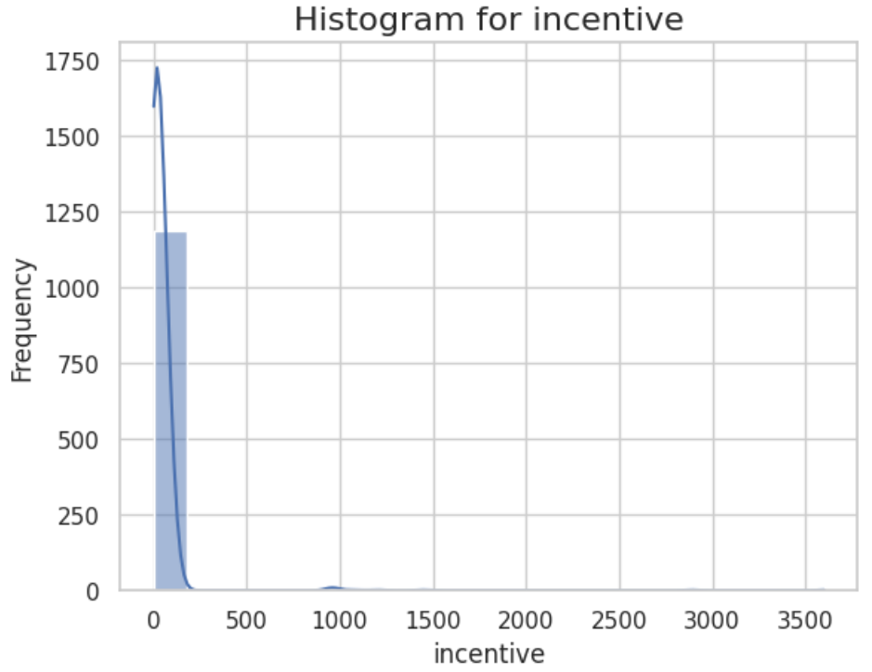
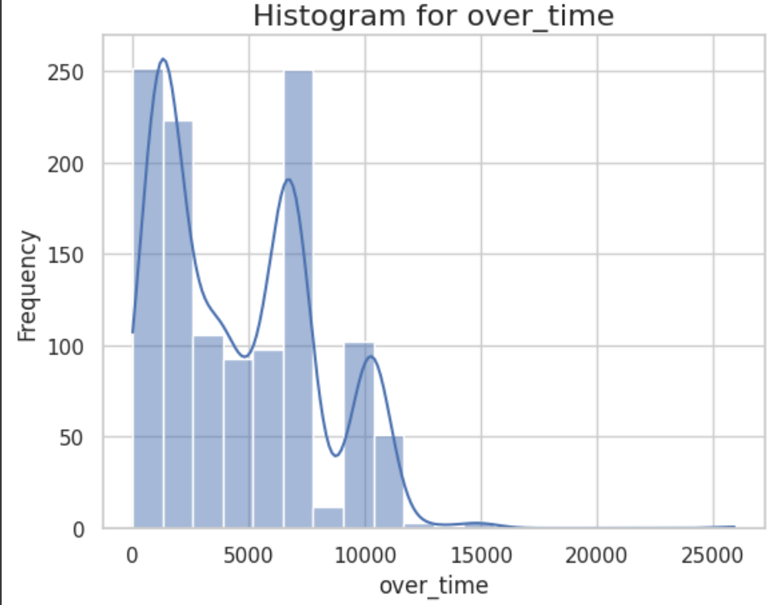
HISTOGRAMS
6

Slide 9
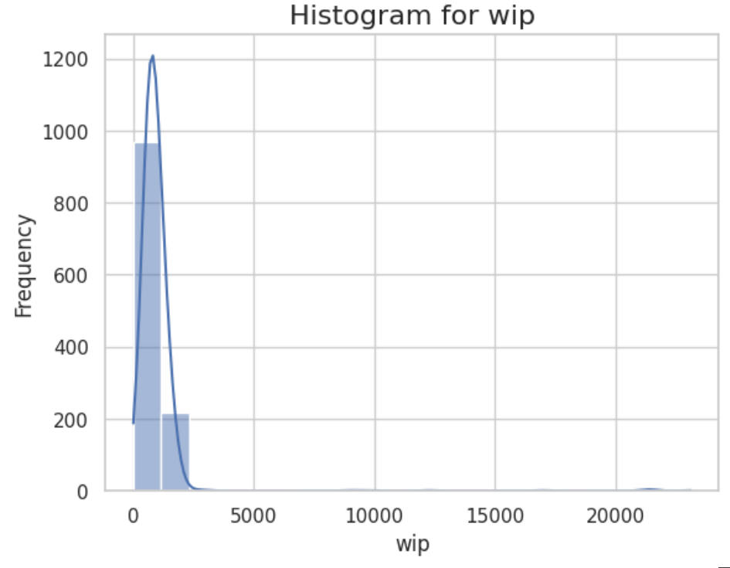
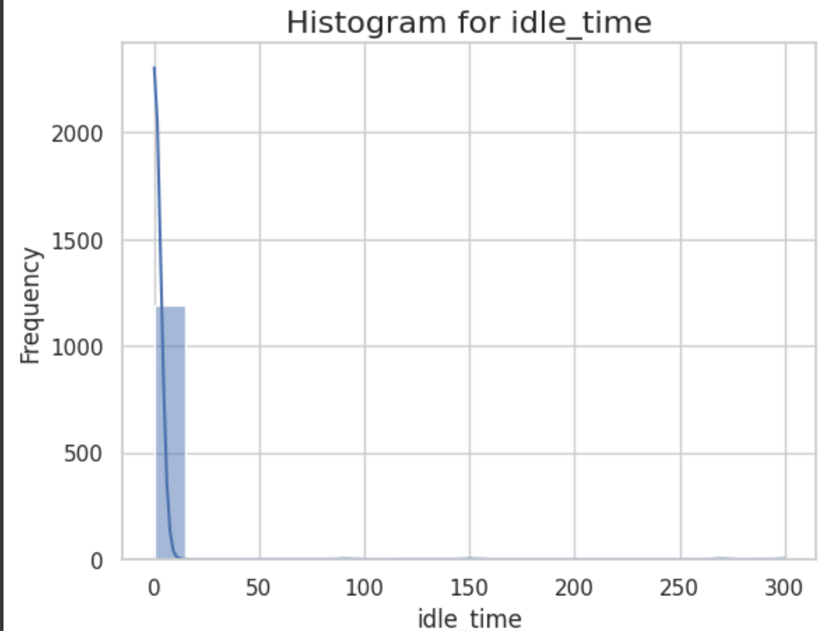
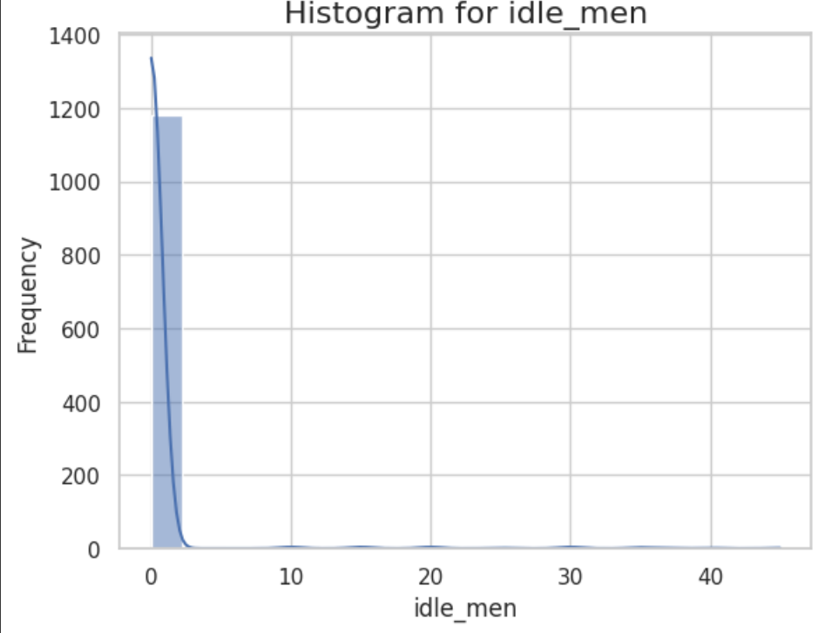
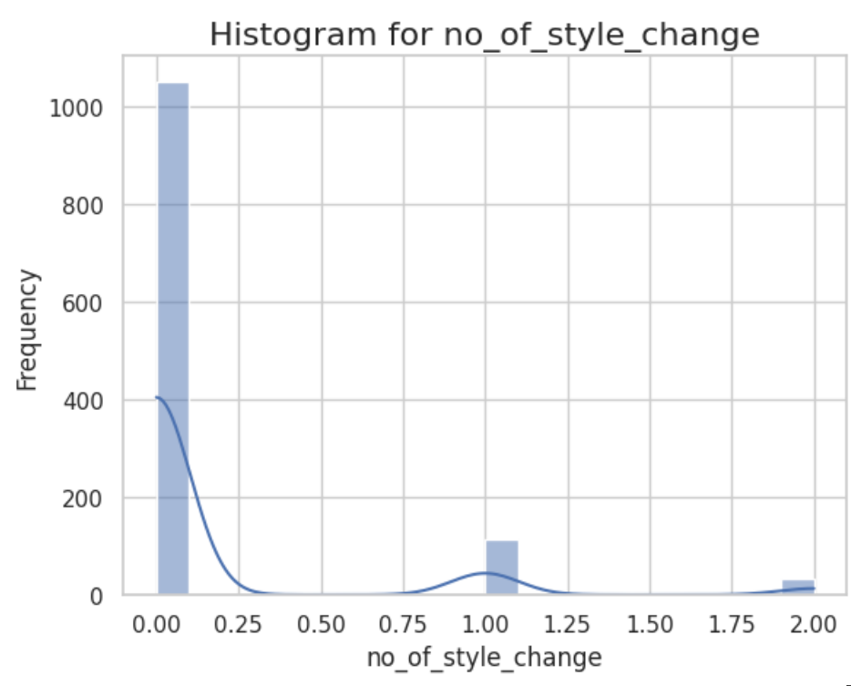
7

Slide 10
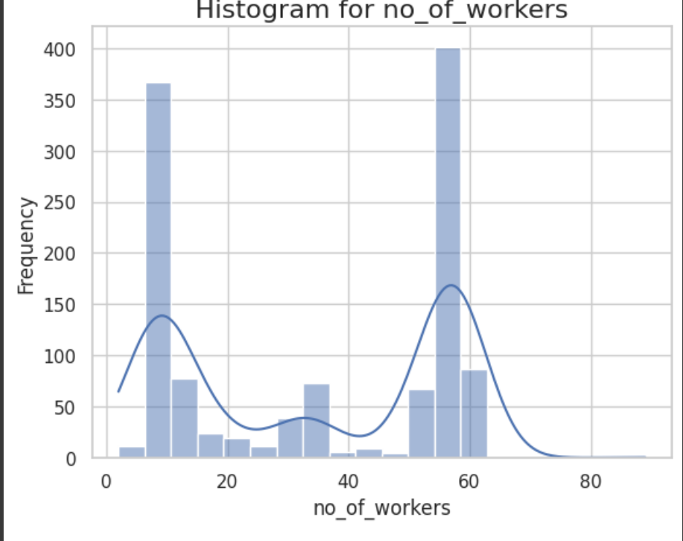
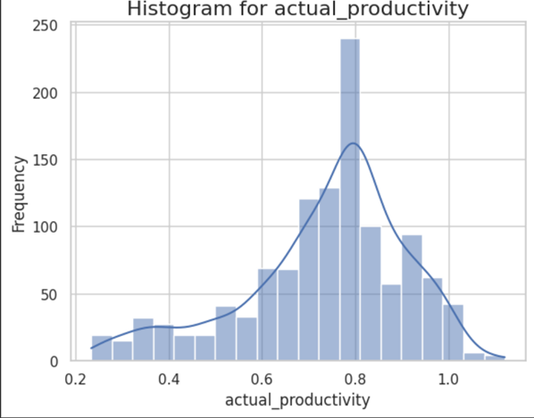
8

Slide 11
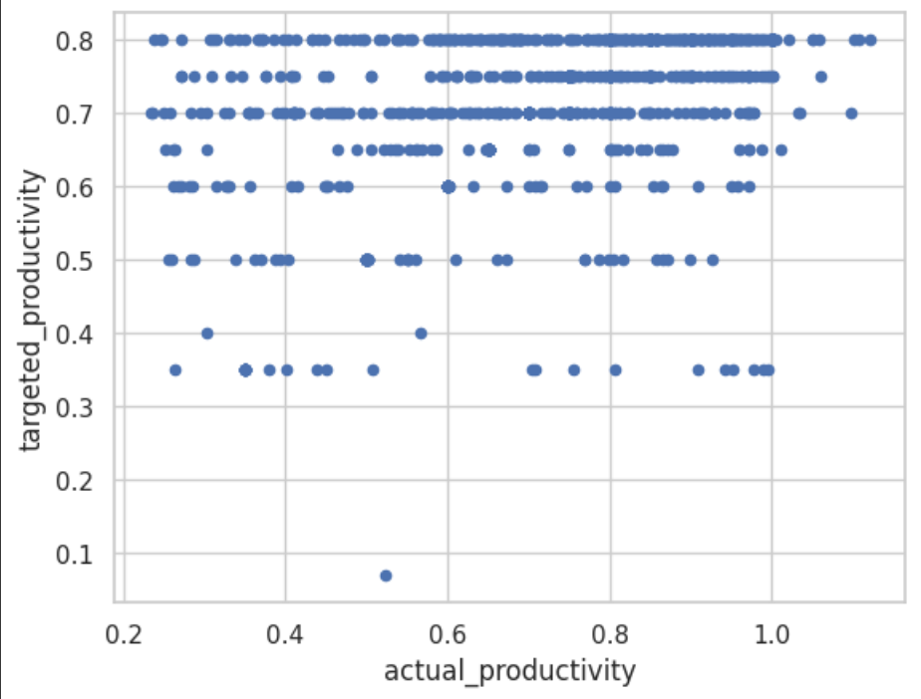
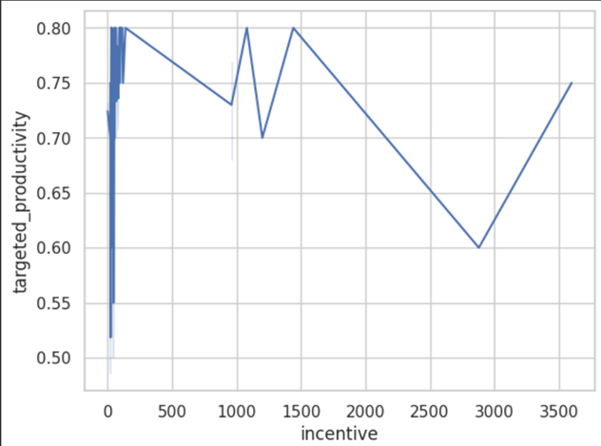
9
SCATTER PLOT
LINE PLOT
scatter

Slide 12
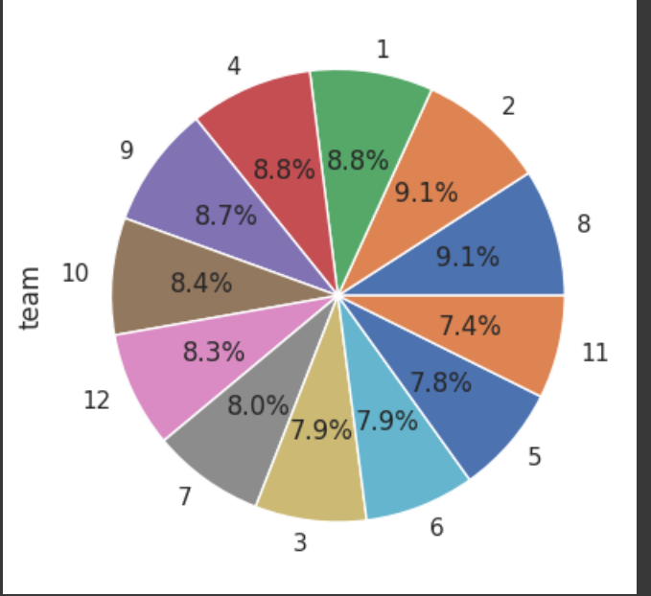
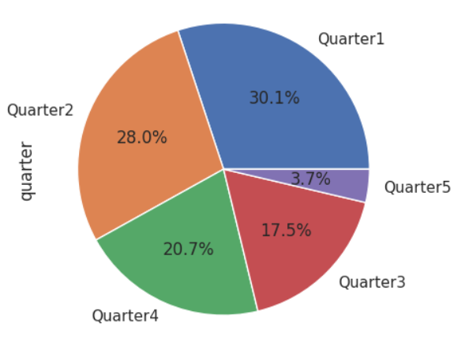
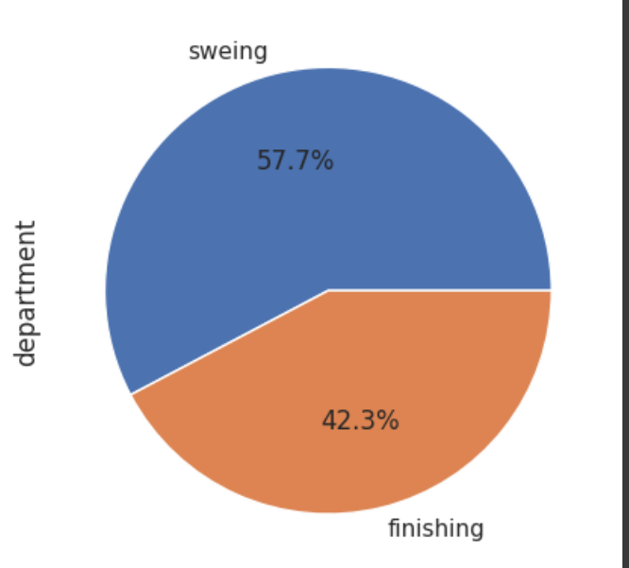
PIECHARTS
10

Slide 13
MACHINE LEARNING ALGORITHAMS:=
LINEAR REGRESSION
11
TRAIN TEST RATIO | MSE | R^2
60-40 | 0.0491 | -0.6828
65-35 | 0.0519 | -0.6941
70-30 | 0.0233 | 0.2177
75-25 | 0.0229 | 0.1838
80-20 | 0.0213 | 0.1949

Slide 14
12
SUPPORT VECTOR MACHINE (SVM)
TRAIN TEST RATIO | MSE | R^2
60-40 | 0.0283 | 0.0309
65-35 | 0.0296 | 0.0339
70-30 | 0.0286 | 0.0403
75-25 | 0.0275 | 0.0221
80-20 | 0.2556 | 0.0372

Slide 15
KNN
13
TRAIN TEST RATIO | MSE | R^2 | N_NEIGHBOR
60-40 | 0.0327 | -0.1217 | 1
60-40 | 0.0243 | 0.1684 | 5
60-40 | 0.0241 | 0.1731 | 7
65-35 | 0.0333 | -0.0875 | 1
65-35 | 0.0254 | 0.1697 | 5
65-35 | 0.0245 | 0.2012 | 7
70-30 | 0.0342 | -0.1466 | 1
70-30 | 0.0249 | 0.1655 | 5
70-30 | 0.0244 | 0.1811 | 7
75-25 | 0.0317 | -0.1280 | 1
75-25 | 0.0245 | 0.1269 | 5
75-25 | 0.0244 | 0.1333 | 7
80-20 | 0.0277 | -0.0460 | 1
80-20 | 0.0232 | 0.1237 | 5
80-20 | 0.0255 | 0.1490 | 7

Slide 16
DECISIONS TREE
14
TRAIN TEST RATIO | MSE | R^2 | MAX_DEPTH
60-40 | 0.0251 | 0.1396 | 1
60-40 | 0.0239 | 0.1798 | 3
60-40 | 0.0215 | 0.2634 | 5
65-35 | 0.0260 | 0.1513 | 1
65-35 | 0.0247 | 0.1929 | 3
65-35 | 0.0210 | 0.313 | 5
70-30 | 0.0261 | 0.1252 | 1
70-30 | 0.0214 | 0.2818 | 3
70-30 | 0.0209 | 0.2984 | 5
75-25 | 0.0242 | 0.1371 | 1
75-25 | 0.0180 | 0.3602 | 3
75-25 | 0.0168 | 0.4010 | 5
80-20 | 0.0220 | 0.1696 | 1
80-20 | 0.0179 | 0.3250 | 3
80-20 | 0.0189 | 0.2879 | 5

Slide 17
RANDOM FOREST
15
TRAIN TEST RATIO | MSE | R^2 | MAX_DEPTH
60-40 | 0.0196 | 0.3261 | 3
60-40 | 0.0173 | 0.4059 | 5
60-40 | 0.0171 | 0.4144 | 7
65-35 | 0.0203 | 0.3371 | 3
65-35 | 0.0185 | 0.3960 | 5
65-35 | 0.0178 | 0.4167 | 7
70-30 | 0.0195 | 0.3454 | 3
70-30 | 0.0174 | 0.4159 | 5
70-30 | 0.0168 | 0.4371 | 7
75-25 | 0.0176 | 0.3745 | 3
75-25 | 0.0155 | 0.4481 | 5
75-25 | 0.0156 | 0.4452 | 7
80-20 | 0.0158 | 0.4032 | 3
80-20 | 0.0133 | 0.4964 | 5
80-20 | 0.0128 | 0.5166 | 7

Slide 18
ADA BOOST
16
TRAIN TEST RATIO | MSE | R^2 | LEARNING-RATIO | N_ESTIMATOR
65-35 | 0.0205 | 0.3296 | 0.01 | 100
65-35 | 0.0197 | 0.3560 | 0.01 | 500
65-35 | 0.0204 | 0.3339 | 0.1 | 100
65-35 | 0.0206 | 0.3280 | 0.1 | 500
70-30 | 0.0201 | 0.3273 | 0.01 | 100
70-30 | 0.0190 | 0.3619 | 0.01 | 500
70-30 | 0.0199 | 0.3324 | 0.1 | 100
70-30 | 0.0199 | 0.3324 | 0.1 | 500
75-25 | 0.0182 | 0.3516 | 0.01 | 100
75-25 | 0.0179 | 0.3628 | 0.01 | 500
75-25 | 0.0187 | 0.3340 | 0.1 | 100
75-25 | 0.0187 | 0.3340 | 0.1 | 500
80-20 | 0.0160 | 0.3936 | 0.01 | 100
80-20 | 0.0161 | 0.3901 | 0.01 | 500
80-20 | 0.0173 | 0.3455 | 0.1 | 100
80-20 | 0.0174 | 0.3440 | 0.1 | 500

Slide 19
GRADIENT BOOSTING
17
TRAIN TEST RATIO | MSE | R^2 | LEARNING-RATIO | N_ESTIMATOR
65-35 | 0.0216 | 0.2948 | 0.01 | 100
65-35 | 0.0172 | 0.4383 | 0.01 | 500
65-35 | 0.0167 | 0.4532 | 0.1 | 100
65-35 | 0.0178 | 0.4191 | 0.1 | 500
70-30 | 0.0208 | 0.3027 | 0.01 | 100
70-30 | 0.0168 | 0.4366 | 0.01 | 500
70-30 | 0.0168 | 0.4366 | 0.1 | 100
70-30 | 0.0176 | 0.4089 | 0.1 | 500
75-25 | 0.0190 | 0.3228 | 0.01 | 100
75-25 | 0.0155 | 0.4474 | 0.01 | 500
75-25 | 0.0157 | 0.4394 | 0.1 | 100
75-25 | 0.0176 | 0.3740 | 0.1 | 500
80-20 | 0.0171 | 0.3540 | 0.01 | 100
80-20 | 0.0139 | 0.4760 | 0.01 | 500
80-20 | 0.0147 | 0.4447 | 0.1 | 100
80-20 | 0.0152 | 0.4249 | 0.1 | 500

Slide 20
XG BOOST
18
TRAIN TEST RATIO | MSE | R^2 | LEARNING-RATIO | N_ESTIMATOR
65-35 | 0.0195 | 0.3626 | 0.01 | 100
65-35 | 0.0166 | 0.4572 | 0.01 | 500
65-35 | 0.0164 | 0.4641 | 0.1 | 100
65-35 | 0.0188 | 0.3866 | 0.1 | 500
70-30 | 0.0187 | 0.3725 | 0.01 | 100
70-30 | 0.0163 | 0.4520 | 0.01 | 500
70-30 | 0.0160 | 0.4645 | 0.1 | 100
70-30 | 0.0176 | 0.4102 | 0.1 | 500
75-25 | 0.0174 | 0.3817 | 0.01 | 100
75-25 | 0.0149 | 0.4688 | 0.01 | 500
75-25 | 0.0156 | 0.4456 | 0.1 | 100
75-25 | 0.0179 | 0.3630 | 0.1 | 500
80-20 | 0.0155 | 0.4160 | 0.01 | 100
80-20 | 0.0135 | 0.4908 | 0.01 | 500
80-20 | 0.0137 | 0.4835 | 0.1 | 100
80-20 | 0.0143 | 0.4611 | 0.1 | 500

Slide 21
COMPARISION OF IMPLEMENTED MODELS :
19
MODEL | MSE
Linear regression | 0.0213
Support Vector Machine (SVM) | 0.0275
KNN | 0.0232
Gradient Boosting | 0.0139
Decision Tree | 0.0168
Random forest | 0.5166
ADA Boost | 0.0160
XG Boost | 0.0135
LOWEST MSE

Slide 22
CONCLUSION:
20
For Garment worker performance prediction, we performed five types of machine learning algorithms: Linear Regression, SVM , KNN, Bagging and Boosting.
From all the analysis and implementations of the algorithm, we found the best results in Boosting algorithm i.e. in the XG Boost algorithm for 80-20 train-test ratio with lowest MSE of 0.0135.
So, here we can conclude that XG Boost Algorithm can be considered the best model for the given Garment worker performance prediction dataset.

Slide 23
THANK YOU
21
Rajput siddhi Thakur Swetha Bharath . G Vaddepalli murali Shaik Anas

Slide 24
22
Appendix

Slide 25
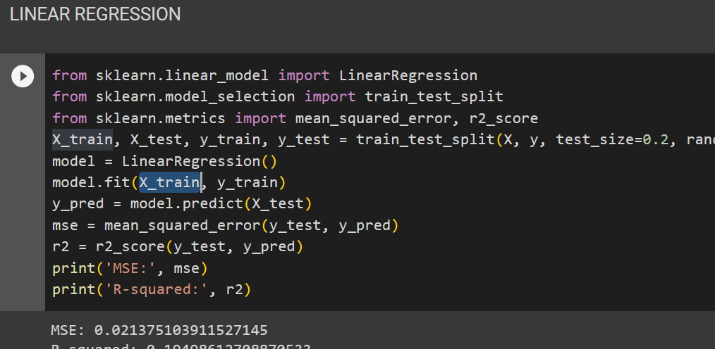
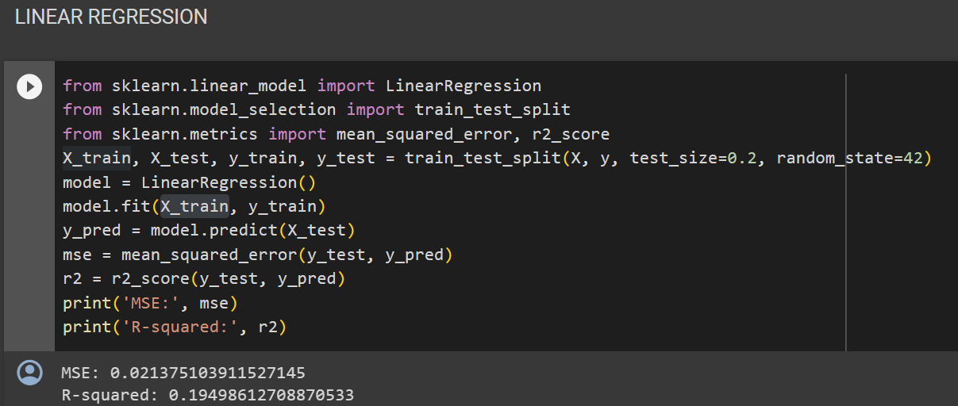
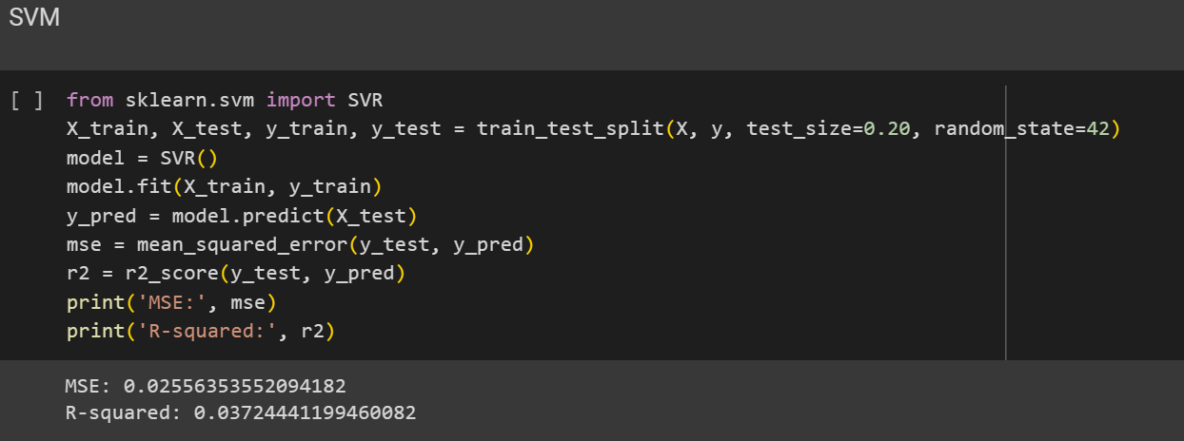
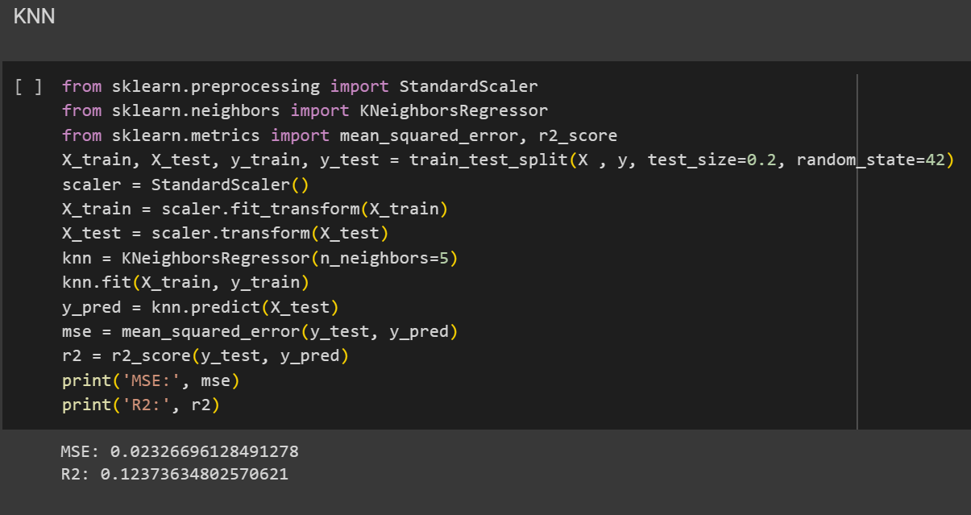
23

Slide 26
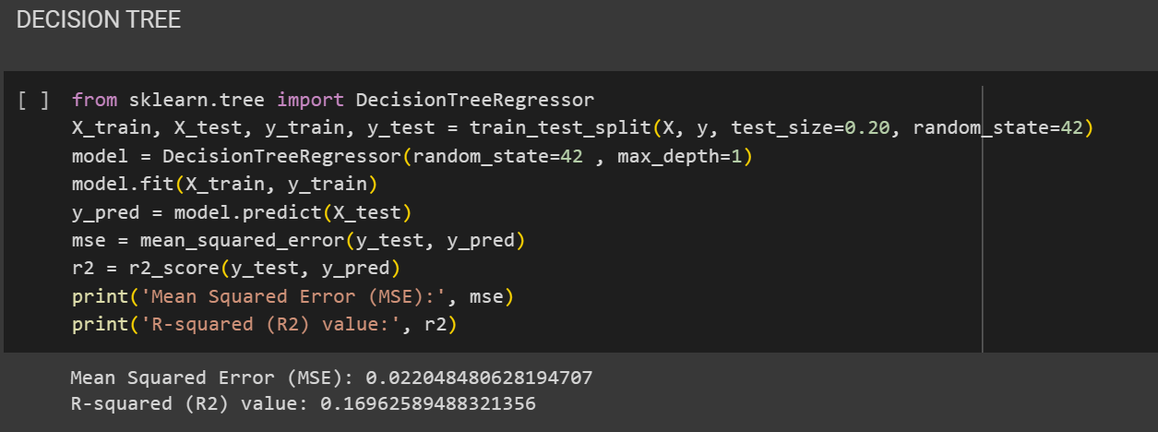
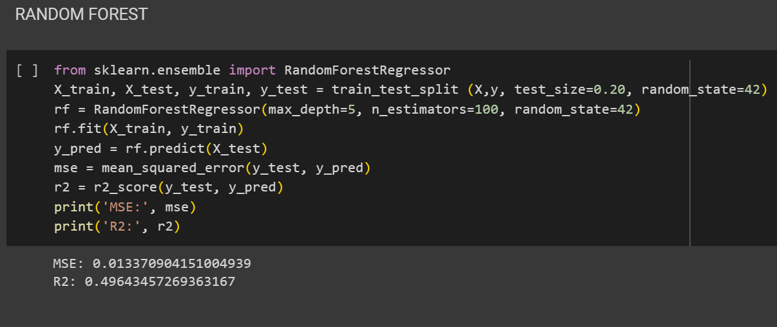
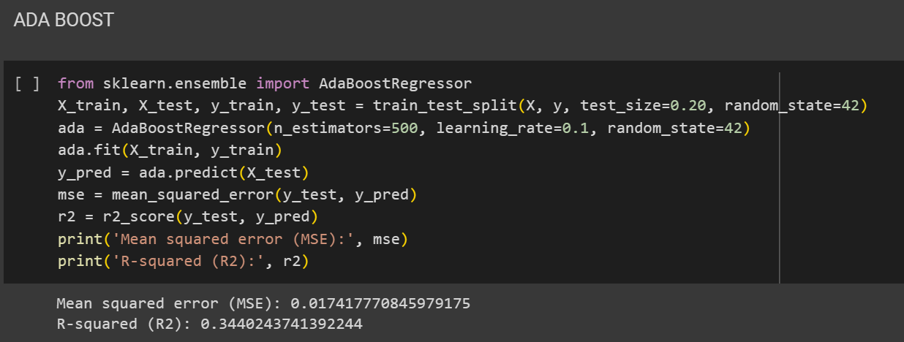
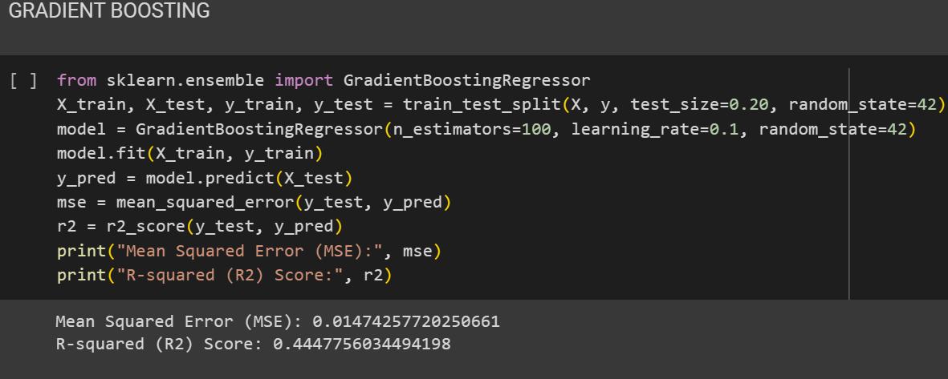
24

Slide 27
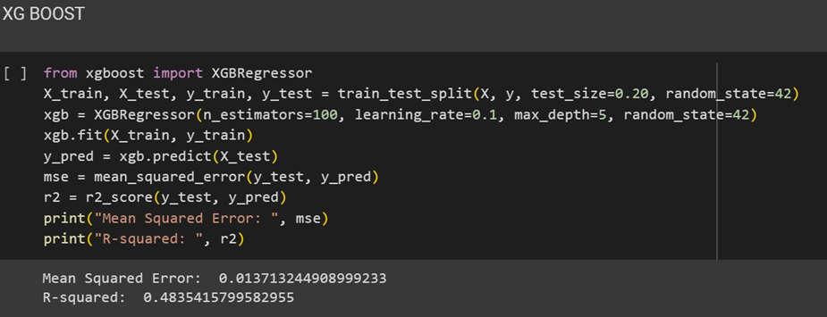
25

